Slide 1
Software Economics
Chapter1

Slide 2
Economics Definition
a social science concerned chiefly with description and analysis of the production, distribution, and consumption of goods and services.
Economics is the study of how people make decisions in resource-limited situations.

Slide 3
Macroeconomics
Macroeconomics is the study of how people make decisions in resource-limited situations on a national or global scale.
It deals with the effects of decisions that national leaders make on such issues as tax rates, interest rates, and foreign and trade policy.

Slide 4
Microeconomics
Microeconomics is the study of how people make decisions in resource-limited situations on a more personal scale.
It deals with the decisions that individuals and organizations make on such issues as how much insurance to buy, which word processor to buy, or what prices to charge for their products or services.

Slide 5
Economics and Software Engineering Management
Microeconomics branch of economics deals more with the types of decisions needed to make as software engineers or managers.
Software deals with limited resources:
There is never enough time or money to cover all the features we would like to put into our software products.

Slide 6
Economics Through development Life Cycle
software engineering economics techniques provide useful assistance through development life cycle:
Feasibility Phase. How much should we invest in information system analyses.
Plans and Requirements Phase. How much should we invest in requirements validation activities
Product Design Phase. Should we organize the software to make it possible to use a complex piece of existing software that generally but not completely meets our requirements?

Slide 7
Economics Through development Life Cycle
Programming Phase. Given a choice between three data storage and retrieval schemes that are primarily execution-time efficient, storage efficient, and easy to modify.
Integration and Test Phase. How much testing and formal verification should we perform on a product before releasing it to users?
Maintenance Phase. Given an extensive list of suggested product improvements, which ones should we implement first?

Slide 8
Economic techniques
For dealing with decision issues, the economics field has evolved a number of techniques
cost—benefit analysis,
present-value analysis,
risk analysis, etc.
Software costs.
The critical problem that underlies all applications of economic techniques to software engineering is the problem of estimating software costs.

Slide 9
decision analysis techniques
Standard optimization techniques can be used when
There is a single quantity such as dollars (or pounds, etc.) to serve as a “universal solvent” into which all of decision variables can be converted.
Or, if the non-dollar objectives can be expressed as constraints (system availability must be at least 98 percent ; throughput must be at least 150, transactions per second),
If cash flows occur at different times, then present-value techniques can be used to normalize them to a common point in time.

Slide 10
Example that compares the cost and benefits
Comparisons in terms of throughput in transactions per second) of two alternative approaches to developing an operating system.
Option A. Accept an available operating system.
Option B. Build a new operating system.
The cost-versus-performance curves for these two options are shown in the next Figure.

Slide 11
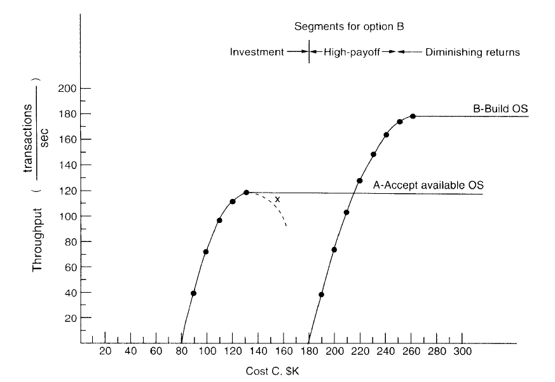
Example that compares the cost and benefits

Slide 12
Example Analysis
Option A. Accept an available operating system.
This will require only $80K in software costs, but will achieve a peak performance of 120 transactions per second, using five $10K minicomputer processors, because of a high multiprocessor over-head factor.
• Option B. Build a new operating system.
This system would be more efficient and would support a higher peak throughput, but would require $ 80K in software costs.

Slide 13
Example Comparison decision
Here, neither option dominates the other, and various cost-benefit decision-making techniques
maximum profit margin,
cost/benefit ratio,
return on investments
must be used to choose between Options A and B.

Slide 14
Software decision
Options A and B may have several important criteria on which they differ
(e.g. , robustness, ease of tuning, ease of change, functional capability).
If these criteria are quantifiable, then some type of figure of merit can be defined to support a comparative analysis

